Slide 1
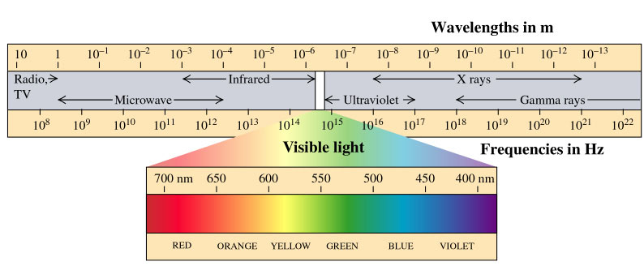
Maxwell Equations –
Electromagnetic Waves
PC2232 Lecture 01

Slide 2
Outline
Maxwell Equations
Simple Plane Electromagnetic Wave
Electromagnetic Wave Equation
EM Wave in Matter
Sinusoidal EM Wave
Poynting Vector and Radiation Pressure
Standing Wave in a Cavity

Slide 3
Introductory Remarks
Light plays an important part of man’s existence (imagine a world without light). Thinkers have pondered over the nature of light since ancient time. A debate on whether light is a wave or is made up of particles seemed to be finally “settled” only when Young conducted his famous double-slit experiments in 1801.
But what it is remained unknown until 1865 when Maxwell in a stroke of genius unified not just electricity and magnetism, but also discovered the true nature of light.
We start our “story” by reviewing some of the ideas you have dealt with in EE2011 – Maxwell’s equation & EM waves. We will focus mainly on the wave nature of light.
However, trying to really understand how it interacts with matter ultimately led to one of the most counter-intuitive and important discoveries and change our way of thinking about the world around us – we will again look into this after the first three weeks.

Slide 4
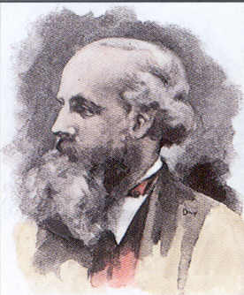
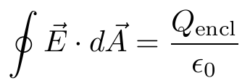
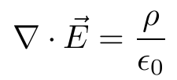
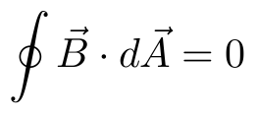

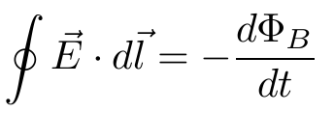
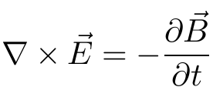
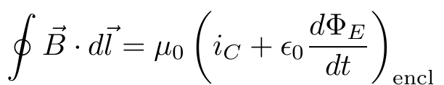
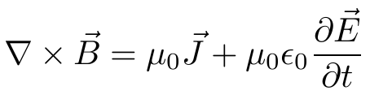
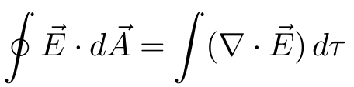
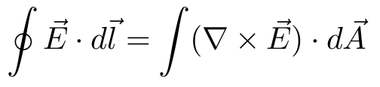
Maxwell Equations
In 1865 James Clerk Maxwell (1831 – 1879) summarized the known laws of E&M into 4 equations (the Maxwell’s Equations):
 | Integral Form | Differential Form
Gauss’s Law
Gauss’s Law (magnetism)
Faraday’s Law
Ampere’s Law
Divergence
Theorem
Stokes’
Theorem

Slide 5
Implications of Maxwell’s Equations
A time-varying magnetic field acts as a source of electric field, and vice versa.
Thus, when either an electric or a magnetic field is changing with time, a field of the other kind is induced in the adjacent regions of space.
Maxwell was led to consider the possibility of an electromagnetic disturbance, consisting of time-varying electric and magnetic fields, that can propagate through space from one region to another.
Such a disturbance would have the properties of a wave, and is called an electromagnetic wave (EM wave).
An accelerating charge produces a changing field and EM Wave!

Slide 6
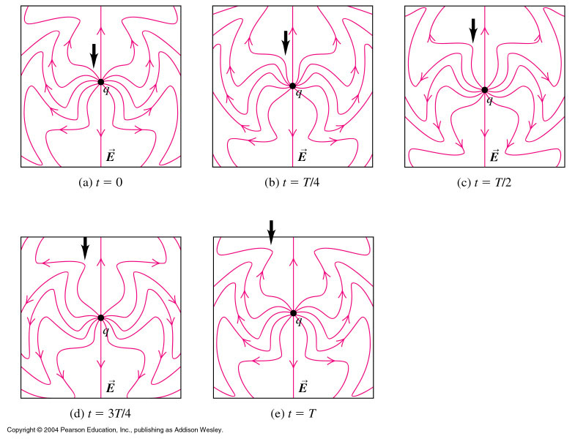

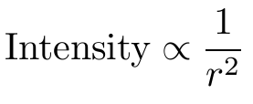
Generating EM Radiation
Electric field due to an accelerating charge:
Important:
Physlet Simulation
http://phet.colorado.edu/en/simulation/radiating-charge

Slide 7
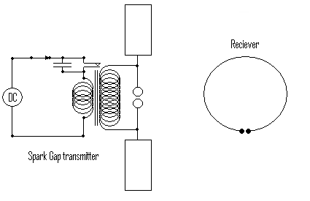
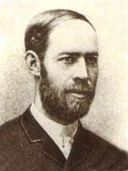
Heinrich Hertz – An unexpected effect
In 1886, Heinrich Hertz (1857 – 1894) proved the existence of Maxwell’s EM waves. He broadcast and detected radio waves using the setup below. This marked the start of wireless communication – radio, TV, etc. Unit for frequency was named after him.

Slide 8
Types of EM waves
EM waves are called different names depending on its wavelengths and how they are produced.
Covers an extremely large range of wavelength.
We will deal mainly with visible light in our module (and leave the others, such as radio and microwaves to other EE modules.)

Slide 9
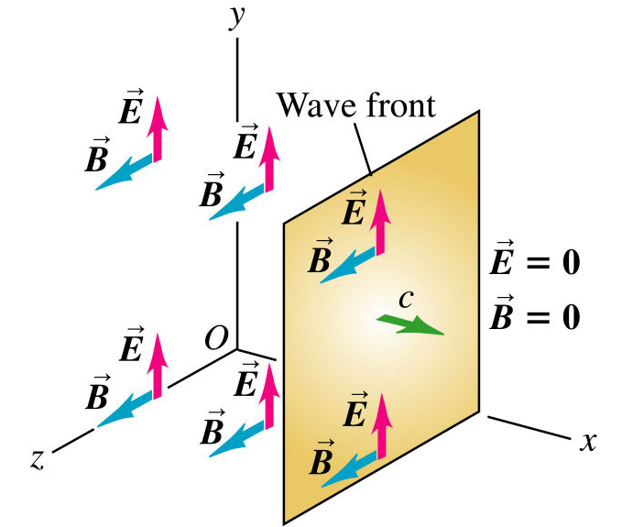
Simple Plane EM Wave
Consider a very simple configuration:
  Left of plane: Uniform electric field E in +y direction (everywhere), uniform magnetic field B in +z direction.
  Right of plane: zero field everywhere.
  Wavefront moving at constant speed c in +x direction.
Don’t worry about how to produce this. Just consider whether this configuration can satisfy all four Maxwell’s equation or what can we say about the waves if they are to obey the Maxwell equations.

Slide 10
Simple Plane EM Wave
Consider Gauss’s Laws (1st and 2nd Maxwell’s equation):
  Gaussian surface is a rectangular box as shown, part of it is on the left of wavefront.
  Enclosed charge = 0 and net flux = 0?
True since both E and B are perpendicular to propagation direction – does not have any component in the x-direction!!
Transverse wave!!

Slide 11
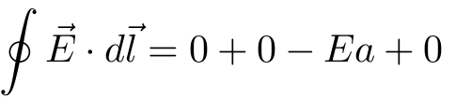
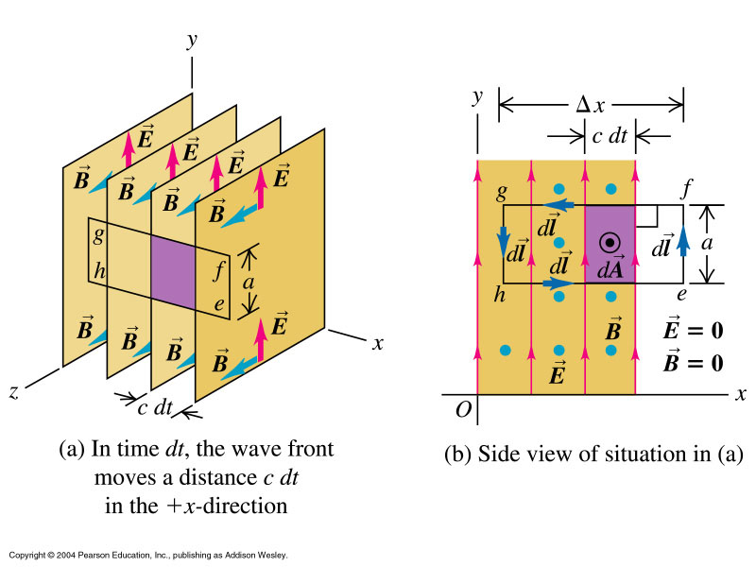

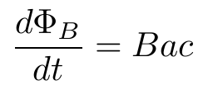


Simple Plane EM Wave
Consider Faraday’s Law:
  Rectangle efgh parallel to x-y plane.
Note also that B has to be in the direction indicated wrt E.

Slide 12
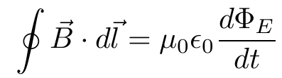
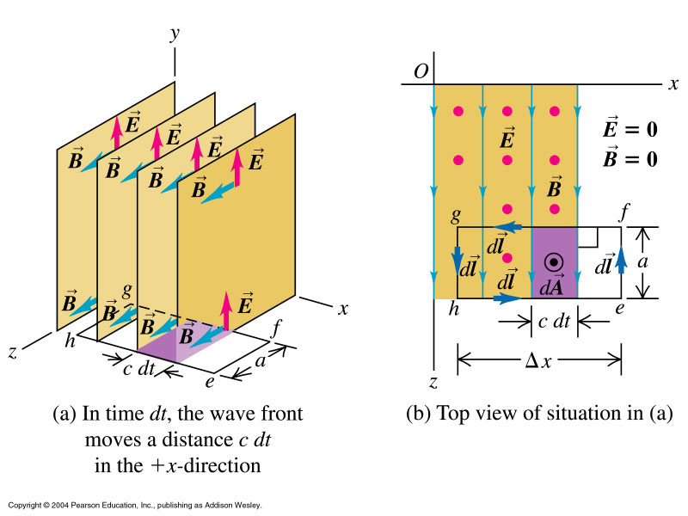
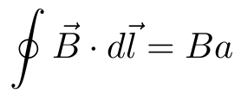
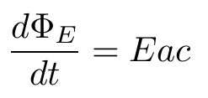


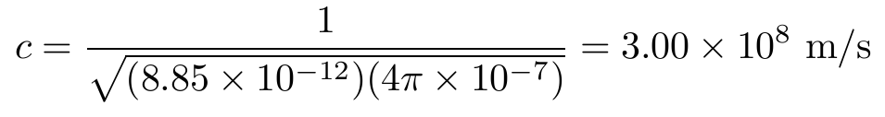
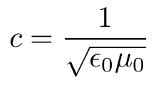
Simple Plane EM Wave
Consider Ampere’s Law (i_{C} = 0):

Slide 13
Some Key Properties of EM Waves
Transverse: E and B perpendicular to direction of propagation of wave which is the direction indicated by E × B.
There is a definite ratio between magnitudes of E and B: E = cB.
Speed in vacuum c is constant and independent of frequency.
No need of any medium for transmission of wave.

Slide 14
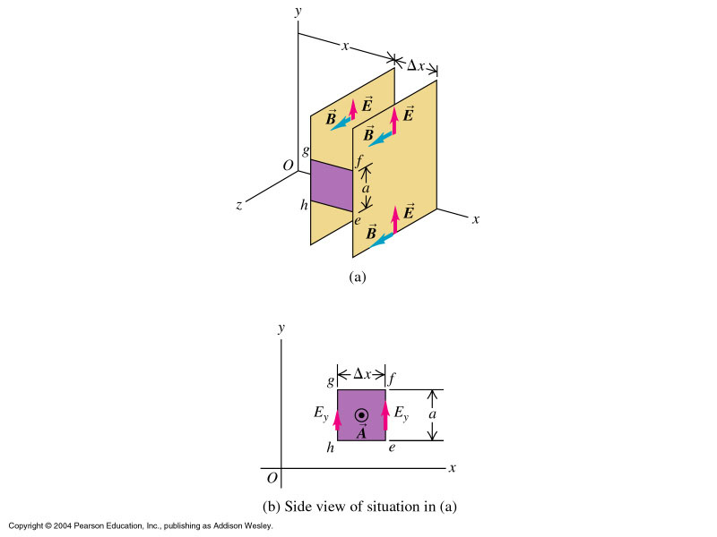
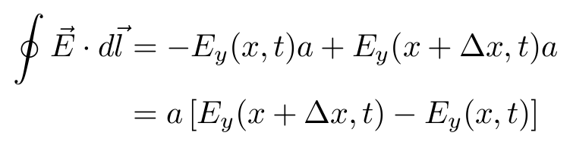
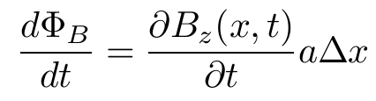

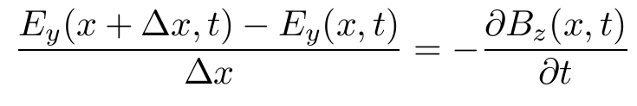
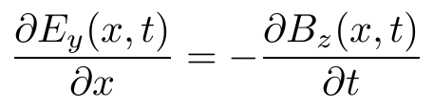
Electromagnetic Wave Equation
Consider again plane waves with E and B constant in each plane (same x) but different for different planes (different values of x).
For the rectangle loop efgh:
For small Δx, B is nearly constant in loop.

Slide 15
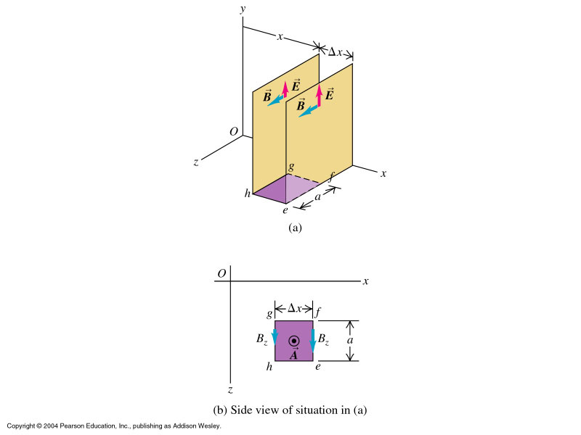
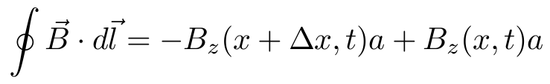
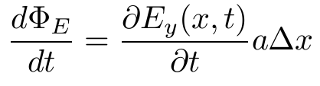

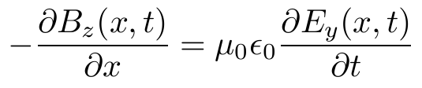
Electromagnetic Wave Equation
Similar for loop efgh shown,
For small Δx, E is nearly constant in loop.
By Ampere’s Law

Slide 16
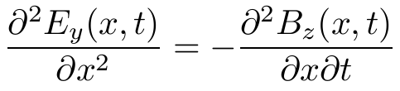
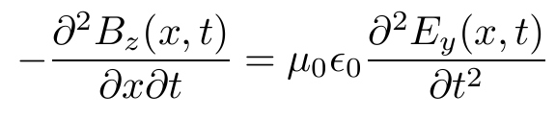
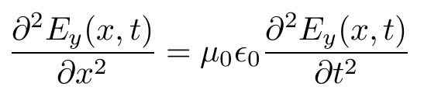
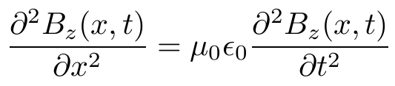
Electromagnetic Wave Equation
Take partial derivative wrt x and t for the 1st and 2nd equations respectively:
By taking the partial derivative the other way, we can also show that:

Slide 17
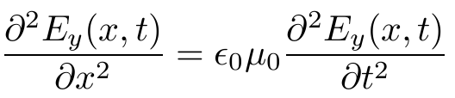
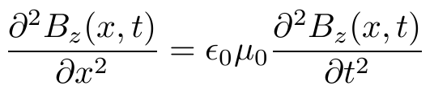
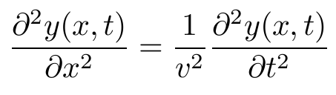
Wave Equations
Electromagnetic Wave Equation:
Compared to mechanical waves, the wave equation is:
where v = velocity of propagation

Slide 18
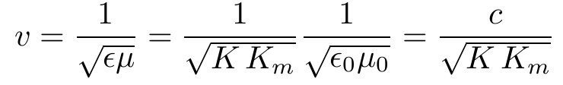
Electromagnetic Waves in Matter
EM waves may also propagate in nonconducting materials, i.e., dielectrics.
In this case, the wave speed would not be the same as in a vacuum, and we denote it by v instead of c.
Furthermore, ε₀ and μ₀ in Maxwell's equations are replaced by ε = Kε₀ and μ = K_{m}μ₀, respectively (ε = permittivity of dielectric, K = dielectric constant, μ = permeability, K_{m} = relative permeability)
Following the same procedure as for waves in a vacuum, we find that

Slide 19
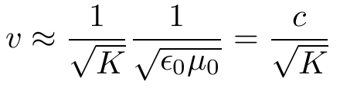

Electromagnetic Waves in Matter
For most dielectrics, K_{m} = 1, and so
Since K is always greater than one, the speed v of EM waves in a dielectric is always less than the speed c in a vacuum.
The ratio of c to v is known in optics as the index of refraction n of the material:
Generally, we cannot take the value of dielectric constant measured using constant electric field to compute n. For example, K for water is 80.4 for steady field, but only about 1.8 at the frequency of light.

Slide 20
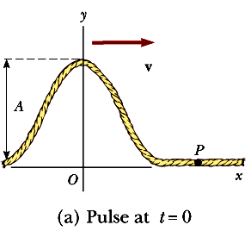

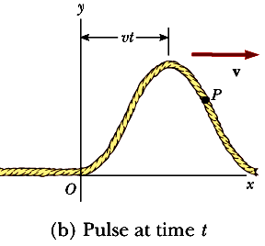

Describing a transverse wave (pulse)
How do we write y as a function of x and t so as to describe the shape of pulse (transverse displacement y at every point x from origin at time t)?
Say at time t = 0, we can write:
Pulse moves to the right with velocity v. Element at x at time t has the same y position as an element located at (x - vt) had at time t = 0:
Aside

Slide 21


Describing a transverse wave (pulse)
Therefore for a pulse moving to the right, we may in general write:
Similarly, for a pulse moving to the left:
y(x,t) is called the wave function. Depends on two variables x and t.
y(x) is called the waveform.
Aside

Slide 22

Ex: Pulse Moving to the Right
A pulse moving to the right is represented by the wave function:
where x and y are measured in cm, t in seconds. Plot the wave function at t = 0, t = 1 and t = 2 seconds
Aside

Slide 23


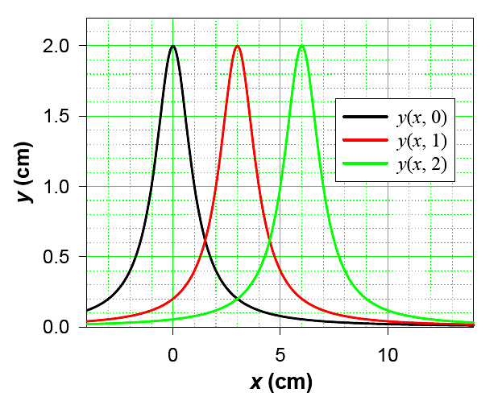


Ex: Pulse Moving to the Right
The pulse is moving to the right with a velocity of
v = 3 cm/s
Aside
Aside

Slide 24
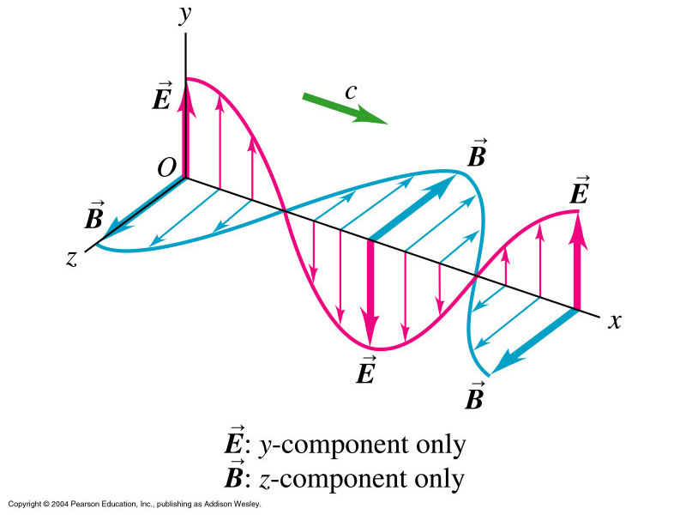


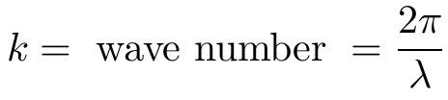

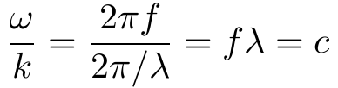


Sinusoidal EM Waves
One solution to the EM Wave Equations is the linearly polarized sinusoidal wave moving to the right (+x direction) as shown:
where
(as expected)
One can of course also use the sine or exponential functions.

Slide 25



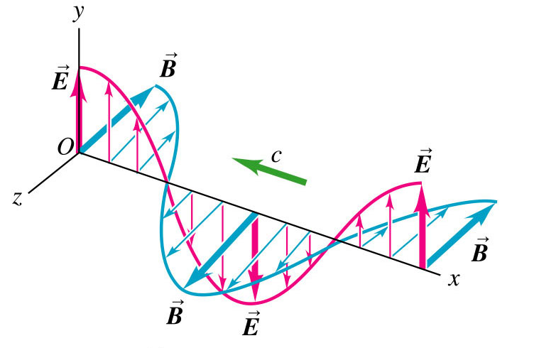


Sinusoidal EM Waves
In vector form:
If the wave is moving to the left (-x direction) then:
(Take note of the orientation of E and B)

Slide 26

Question
In 1973, NASA engineers adjusted the solar panels of Mariner 10 and face the panels towards the sun in a carefully determined orientation. Why?

Slide 27



Energy in Electromagnetic Waves
Like a mechanical wave, EM wave carries energy (in its E and B fields).
Total energy density (energy per unit volume) is given by:
Note that you can review chapter 30 on this point
But B and E are related

Slide 28




EM Energy Flow & Poynting Vector
EM energy passing through area A in time dt
EM power per unit area:
Define Poynting vector (indicating direction – same as propagation direction – and magnitude of energy flow rate) as:

Slide 29


Poynting Vector (sinusoidal EM Waves)
Poynting vector is a function of position and time, e.g., in sinusoidal EM waves:
Intensity (usually average of many cycles for light):

Slide 30



Another Effect of EM field
Consider an EM wave hitting a positive charge as shown. The E-field will drive the charge to move in the y-direction, say with velocity v.
Motion of charge is at right angle to B ⇒ A force given by:
+
acts on the charge in the direction of propagation.
The magnitude of the force is:
But qE is the force acting on particle and is in the same direction as v. Recall that Power (or work done on charge per unit time) = force × velocity. So the EM wave also pushes the charge along the direction of wave with a force of magnitude = energy absorbed per second / speed of light c.

Slide 31




EM Momentum Flow
This is equivalent to saying that EM waves also carry momentum (associated with fields not any particles) !!
Momentum flow rate per unit area
The momentum density (momentum p per unit volume V) is given by:

Slide 32


Radiation Pressure
When EM wave is completely absorbed by a surface, momentum is transferred to the surface, resulting in a force (known as radiation pressure for unit area) on the surface.
If the EM wave is totally reflected by a surface, e.g. polished metal, momentum change is twice and the radiation pressure on the surface is

Slide 33


Examples of Radiation Pressure
Generally radiation pressure is very small. For example, intensity of sunlight on earth’s surface is about 1.4 kW/m². What is the pressure due to this if it is totally absorbed? How much force does this amount to for the whole earth of radius 6380 km?
why?
(Small compared to Sun’s gravitational attraction of 3.5 × 10²² N)
Note that radiation pressure is what keeps the stars from collapsing due to gravitational attraction of their constituents. When the stars stop burning, there is no radiation pressure and it collapses to various objects like neutron stars or black holes!!

Slide 34

Momentum and Radiation Pressure
Hence the radiation pressure exerted on the perfectly absorbing surface is
Radiation Pressure = S/c (Complete Absorption)
If the surface is a perfect reflector (mirror) and the incidence is normal, then the momentum transported to the surface in a time t is twice that for perfect absorbing surface.
Radiation Pressure = 2S/c (Complete Reflection)
Radiation pressures are very small (about 5 x 10⁻⁶ N/m² for direct sunlight), they have been measured with torsion balances such as one shown.

Slide 35
Solar Sailing
NASA is exploring the possibility of solar sailing as a low-cost means of sending spacecraft to the planets.
Large reflective sheets would be used in much the way canvas sheets are used on earthbound sailboats.
In 1973, NASA engineers took advantage of the momentum of the sunlight striking the solar panels of Mariner 10 to make small course corrections when the spacecraft’s fuel supply was running low.
This procedure was carried out when the spacecraft was in the vicinity of the planet Mercury. Would it have worked as well near Pluto?

Slide 36
Radiation Pressure from a Laser Pointer
If a 3.0 mW laser pointer creates a spot that is 2.0 mm in diameter, determine the radiation pressure on a screen that reflects 70% of the light that strikes it. The power 3.0 mW is a time-averaged value.
Poynting vector of the beam = time averaged power delivered via the EM wave by the cross sectional area of the beam
S = power/area = Power/πr²
S = 3x10⁻³/[π(2x10⁻³/2)²] = 955 W/m²
Imagine that the surface absorbs the beam ➔ radiation pressure of S/c and then reflect the beam resulting in additional pressure of fS/c where f is fraction of the beam reflected. Hence
Radiation Pressure = S/c + fS/c = (1+f) S/c
Radiation Pressure = (1+0.7) 955/3x10⁸ = 5.4 x 10⁻⁶ N/m²

Slide 37
Solar Energy
The sun delivers about 1400 W/m² of energy to the Earth’s surface via electromagnetic radiation. (a) Calculate the total power that is incident on a roof of dimensions 8m x 20 m. (b) Determine the radiation pressure and the radiation force exerted on the roof, assuming that the roof covering is a perfect absorber.
The magnitude of the Poynting vector for solar radiation at the surface of the Earth is S = 1400 W/m², this represents the power per unit area, or the light intensity.
Assuming that the radiation is incident normal to the roof, we obtain Power = SA = 1400 x 8 x 20 = 2.24x10⁵ W
(b) Radiation Pressure = S/c = 1400/3x10⁸ = 4.67 x 10⁻⁶ N/m²
Since pressure equals force per unit area
Force = Pressure x area = 4.67x10⁻⁶ x 8x20 = 7.47x10⁻⁴ N

Slide 38

Pre-lecture: Crooke’s Radiometer
This is an interesting gadget invented in 1873 by Sir Williams Crookes.
The Crooke’s radiometer is made up of a glass bulb from which much of the air has been removed to form a partial vacuum. Inside the bulb, on a low friction spindle, is a rotor with several (usually four) vertical lightweight metal vanes spaced equally around the axis. The vanes are polished or white on one side, black on the other.
The vane rotates when exposed to sunlight or other heat sources such as an incandescent lamp.
Can you figure out or guess which direction the vane would rotate?

Slide 39

Crooke’s Radiometer
Crookes thought that the motion was due to radiation pressure. The white sides receive twice the momentum transfer compared to the blackened sides and the imbalance should cause the system to rotate.
Even Maxwell originally supported the idea (which supported his theory).
But in actual fact, the vanes rotate opposite to what they should be moving!!
http://en.wikipedia.org/wiki/File:Crookes_radiometer_moving.gif
Recall from previous example that radiation pressure is really small – see if you can estimate it. Only detectable if equipment is extremely sensitive.
Other effects, mainly thermal, plays a more important role. The blackened side is slightly warmer. Greater momentum transfer from molecules? Thermal transpiration, Einstein’s explanation… Check it out yourself!
A failed demonstration that causes much discussion for a long time – even now. And inspire research at world top universities.

Slide 40



Reflection off a conducting surface
Suppose a wave going in –x direction hits a perfectly conducting surface. The wave will be reflected and move in the +x direction.
Sum of E-field due to incident and reflected waves must be zero everywhere and at all times on the conducting surface! So
y
Reflected
Incident
c
z
x
Conducting surface

Slide 41

Reflection off a conducting surface
Similarly, the sum of the B-fields is given by:
y
Reflected
Incident
c
z
x

Slide 42









Reflection off a conducting surface
The equations are equations of standing waves
(Nodes for E-field)
(Nodes for B-field)

Slide 43


Standing Waves in a Cavity
If we insert a second conducting plane parallel to the first at distance L, then it is possible for the system to support standing waves of different possible wavelengths (analogous to a stretched string).
Both conducting planes must be nodal planes for E. So L must be integral multiples of λ/2 (half-wavelengths), i.e.,
The corresponding frequencies are

Slide 44
Standing Waves in a Cavity
Example: Microwave Oven
A microwave oven sets up a standing EM wave with = 12.2 cm, this is a wavelength that is strongly absorbed by the water (why?) in food.
Can one measure this wavelength? (Here comes cheese!)
Youtube video and animation
http://www.youtube.com/watch?v=M2qzCQ58_7Q
http://phet.colorado.edu/en/simulation/microwaves
Why do you rotate the food when you heat it up in microwave oven?
Note that the idea of standing wave in Cavity is also important in operation of laser (will elaborate there).

